Slide 1
“Partner UP!”

Slide 2
How do YOU help with the OPIOID Epidemic?
START AT HOME
Centralize all your medications
Keep current medications in original containers
Put the expired or unwanted ones in a zip lock bag for disposal.
Place current pain medications (opioids) in locked or very secure place

Slide 3
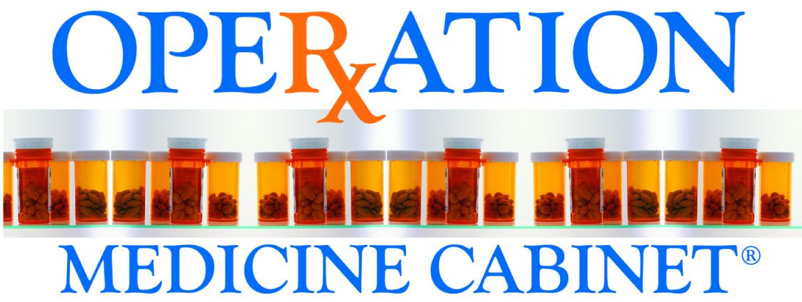
A Pharmaceutical Take Back Program brought to you by:
A Prescription for Safe Kids and a Clean Environment

Slide 4
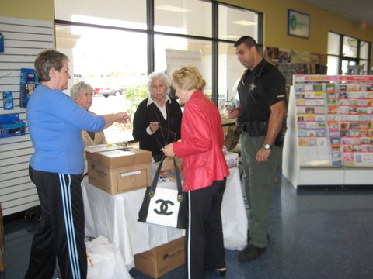
What is a Pharmaceutical Take Back Program?
Start at HOME, collect your unused and expired medication.
Prepare them for disposal at a permanent location or an event.
Place your necessary medications in a secure or
locked area.
Operation Medicine Cabinet® (OMC) collects all pharmaceuticals that are expired or unused to prevent flushing or being placed in landfill.
All pharmaceuticals are incinerated.
Program evolving from events to permanent boxes at many locations.

Slide 5
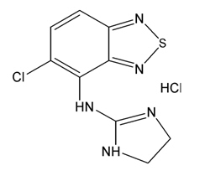
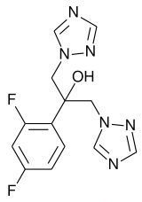
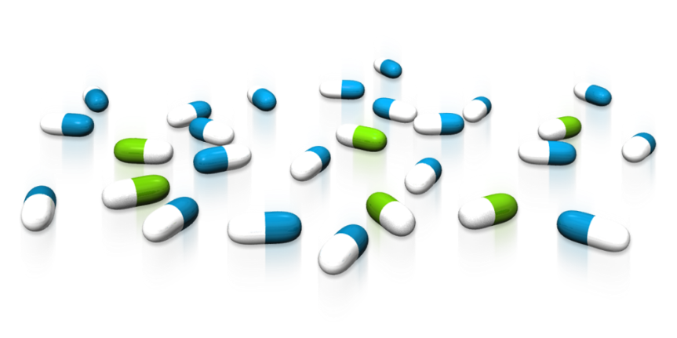
What are Pharmaceuticals?
Antibiotics
Anti-inflammatories
Beta-blockers
Anti-depressants (SSRIs)
Steroids
Hormones, estrogen replacements, BC pills
Chemotherapeutics
Stimulants

Slide 6
Pharmaceuticals (cont’d)
Wide range of biologically-active chemicals
Three classes by sale/regulation
Over the counter
Prescription (or “Legend”)
Controlled Substances (opioids)
Some designated as hazardous waste

Slide 7
Pharmaceuticals (opioids)
Controlled Substances Regulated by the Federal Drug Enforcement Administration due to potential for abuse.
Schedule I – illegal drugs (ex. Heroin, marijuana, LSD)
Schedule II – morphine, OxyContin, codeine, Demerol, Ritalin, amphetamines
Schedule III – Tylenol with codeine, Vicodin
Schedule IV – benzodiazepines, Valium, Darvon
Schedule V – codeine cough syrups.

Slide 8
What’s the Problem?
Kids think prescription drugs are safe – mom, dad & grandma take them!
86% of emergency room visits for medicine poisoning were due to a child getting into adult medicine. (National figures 2017)
Thirty-six percent of Collier County youth began using some form of drugs at age 13 or younger.
Elderly may leave medications out, exposing them to misuse or theft.
Pollution of our waters and our environment.
Florida has the 16th Highest Drug Overdose Mortality Rate in the U.S.
Prescription drugs are found more often than illicit drugs as being the cause of death or present at death.

Slide 9
How can you bring awareness to your community?
OMC events collect all pharmaceuticals from citizens at convenient locations.
Law enforcement complies with DEA regulations and statutory requirements for handling controlled substances at each event.
We educate citizens:
raising awareness of drug and alcohol issues,
giving safety tips for children and seniors,
instruction on proper storage (lock up all medications at home)
proper disposal by incineration not flushing.
Developing a list of permanent sites in your community.

Slide 10
Solutions, “Partner UP!”
A 2014 update to the Safe Drug Act allows pharmacies to collect controlled substances.
Have on site collections with volunteers and law enforcement when planned. (next DEA Take Back Program, April 25, 2020)
During 2020, Walgreens, CVS (Target), Walmart will open disposal sites. We will be the directors.
Secure return mail bag system to conveniently send from home for people who receive prescriptions via mail.
We will coordinate each county that would like to participate

Slide 11
Think Safety!
Lock up all medications - keep them away from children/teens.
Remember, over-the-counter medications can also be abused.
Keep medications in original containers to prevent
accidental misuse.
Never flush medications down the toilet or put in the trash. It is a danger to our environment.
Contact Veora Little, veoralittle@gmail.com for assistance in your county.

Slide 12
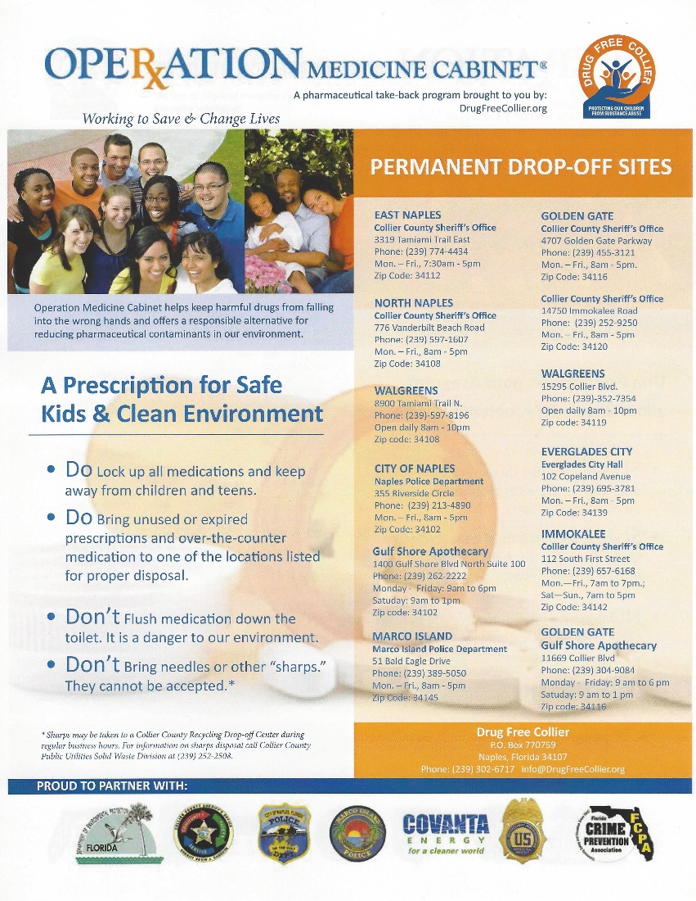
Operation Medicine Cabinet Drop Off Sites

